Slide 1
Tableau
02_Scenarios
Formatting Visualization & Analysis

Slide 2
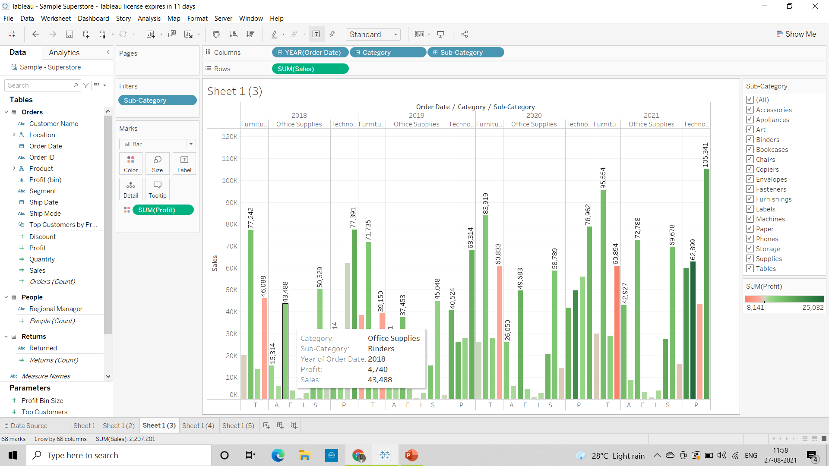
1) Find the profit and sales for each subcategory of every type of product.

Slide 3
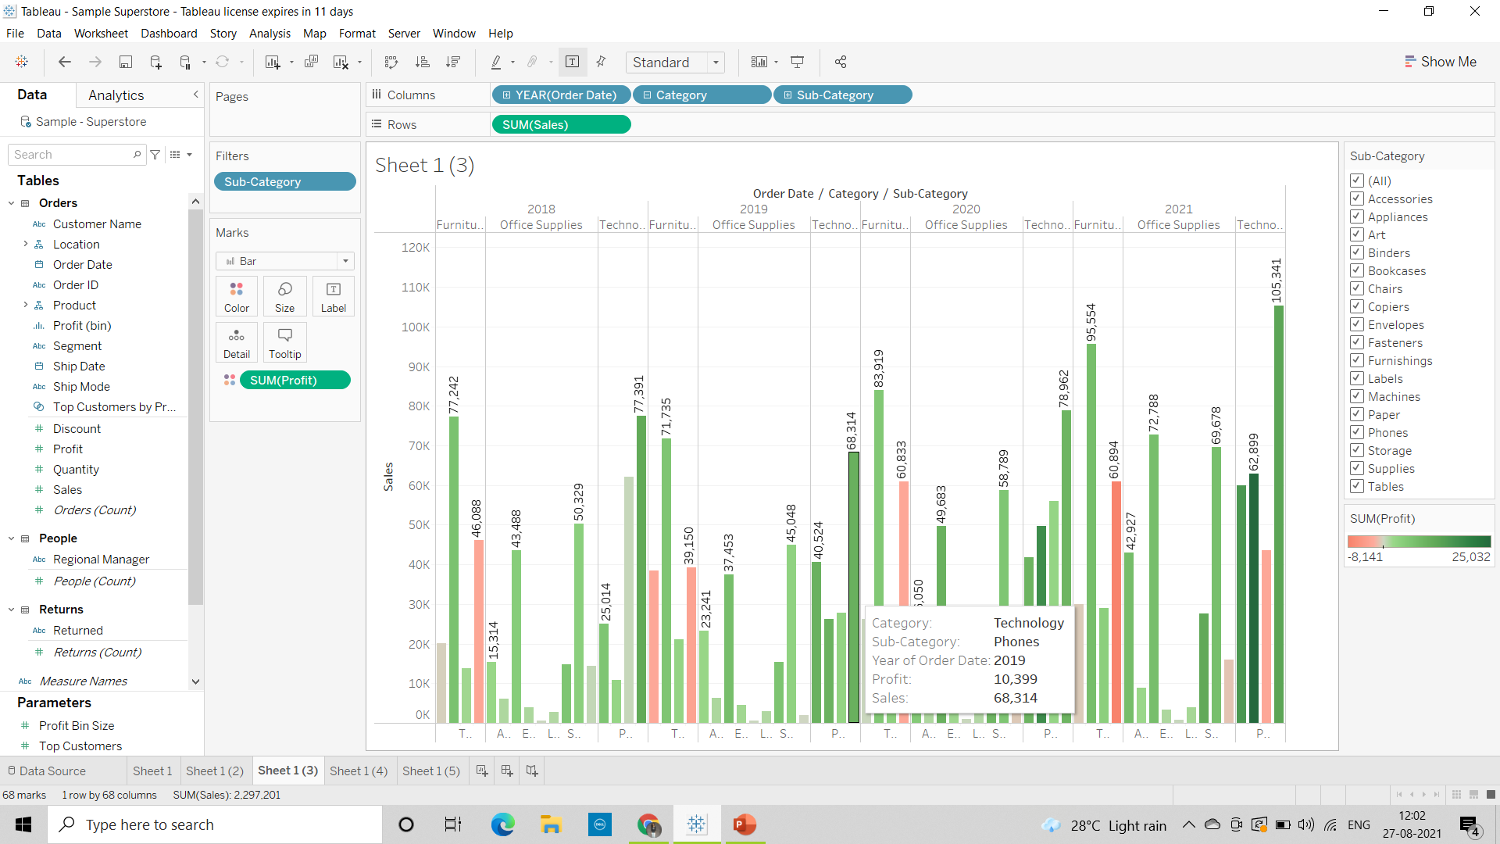
2. Which subcategory has highest profit in the year 2019. for phones sub category there is a highest profit in the year 2019

Slide 4
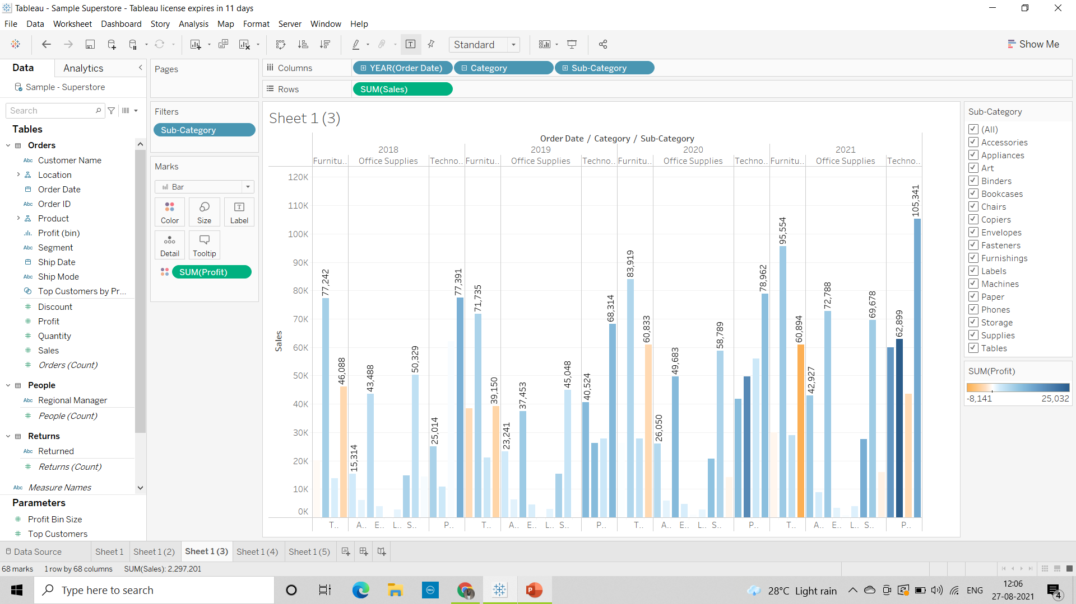
3. In case 1, change the color of the view from the Marks card.

Slide 5
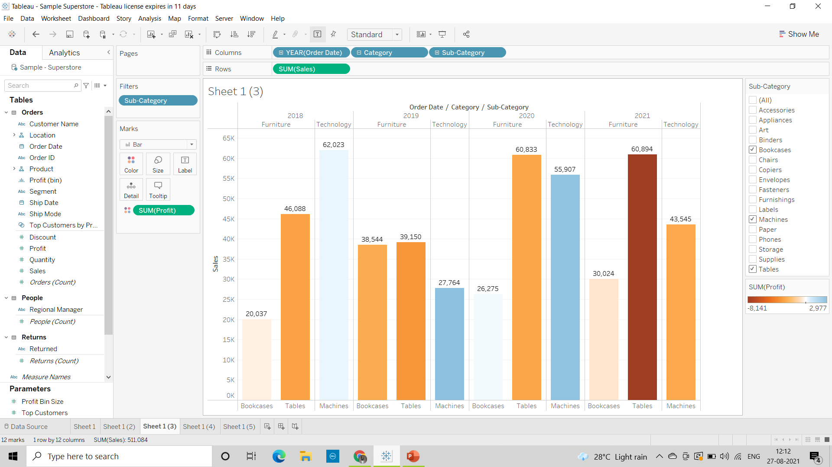
4. In the view, in the Sub-Category filter card, clear all of the check boxes except Bookcases, Machines, and Tables to have closer look on each value.

Slide 6
5. Find out the key insights about in which year bookcases and machines were profitable and unprofitable.
In year 2018 bookcases were unprofitable (-346)
Machines were profitable(369)
In year 2019 bookcases were unprofitable (-2755)
Machines were profitable(2977)

Slide 7
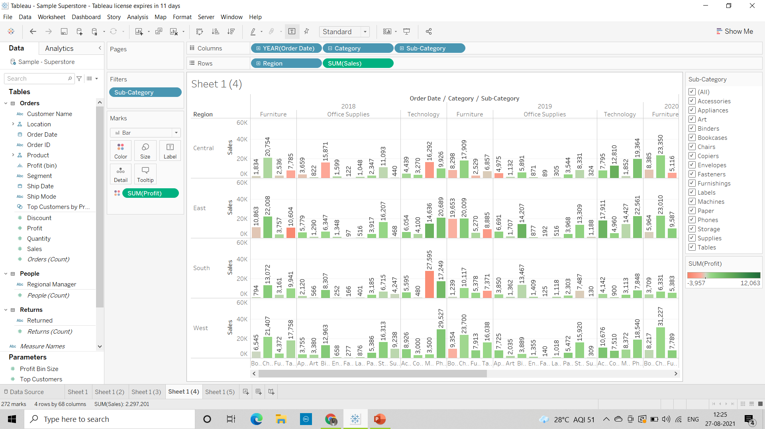
6. Show the sales region wise for every subcategory and category and every year

Slide 8
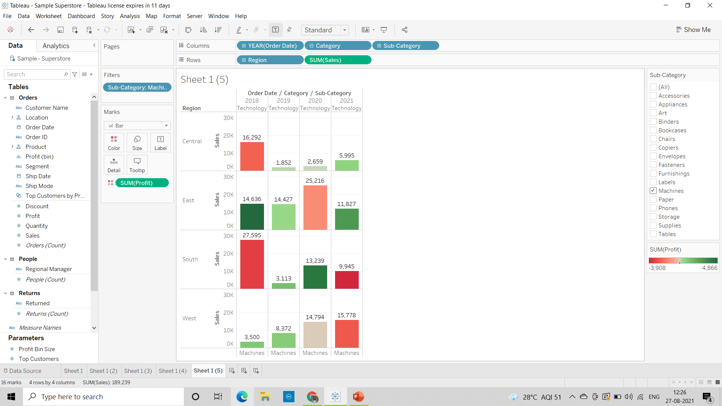
7. Duplicate your worksheet and check sales region vise for Machine type subcategory.

Slide 9
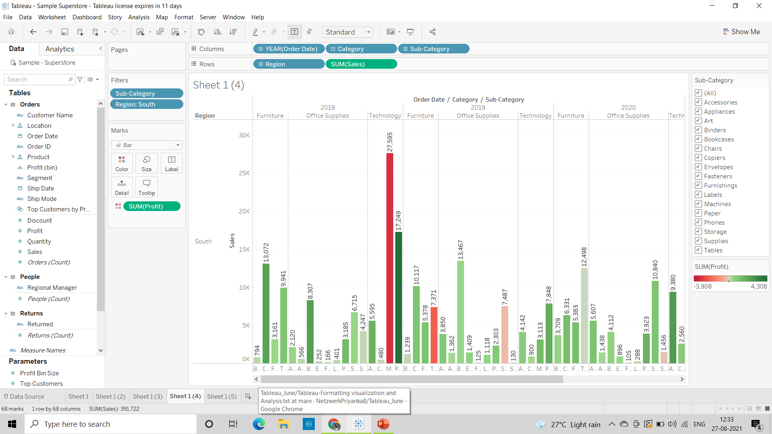
8. In which region you are reporting a higher negative profit overall than in your other regions.
For Central Region in Office Supplies category Binders Sub Category for year 2021 it is showing higher negative profit that is 3,957
9. Show your view for Sales in the South for all subcategory.

Slide 10
10. Which subcategory has highest overall negative sales in the south region.
For Fasteners sub category in year 2020 for Office Suppliers Category it is showing highest overall negative sales(105)
11. Take some decisions to improve sales in the south.
To improves sales in south we need to focus more on furniture category for BookCases and Furnishings sub category because the sales are very low
For Office supplies as well there are many sub categories which are producing very low sales

Slide 11
12. Rename your worksheet.
To rename the worksheet right click on sheet name and select the rename option and rename it or directly double click on the sheet name.
13. Save your workbook.
Go to the file option and select save as then give the name to the file to save the workbook

